Slide 1

Spectrum Protection from Micro-transmissions using Distributed Spectrum Patrolling
Mallesham Dasari, Arani Bhattacharya, Mohammad Bershgal Atique, Samir R. Das
WINGS Lab
Stony Brook University
Notes:
Good afternoon all. My name is Mallesh from Stony Brook. This work is in collaboration with Arani, Mohammad and Samir all from WINGS lab, at Stony Brook. The goal of this work is to understand the implications of using distributed spectrum patrolling for protecting the spectrum.

Slide 2
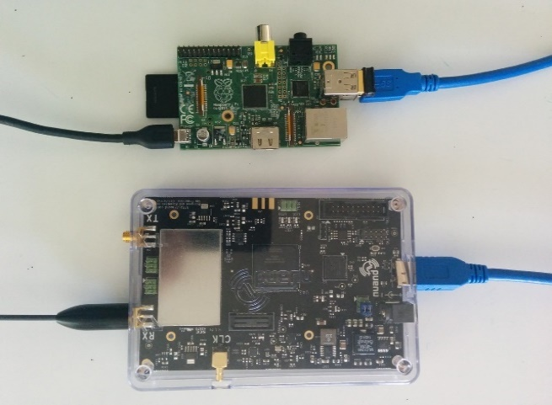
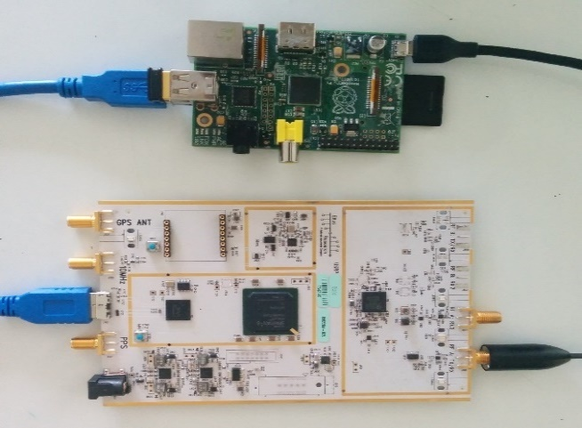

RF Spectrum
Spectrum is a natural resource
Needs protection just like any other natural resource
SDRs making the spectrum more vulnerable to unauthorized use
RTL-SDR
BladeRF
USRP
A common practice to avoid illegal use is to monitor the
spectrum continuously
$20
$200
$700
WINGS Lab
Notes:
So we all know that the wireless spectrum is a precious resource. I am sure you won’t argue with the fact that we cannot survive a day if we don’t have access to an RF spectrum. So we have to protect the spectrum just like any other important resource right. This has become prohibitively difficult because of recent proliferation in software defined radios. An SDR allows you to transmit at any frequency you want to by tuning in the software. For example, well known software radios in the market are RTL-SDR, BladeRF, HackRF, USRP and there exists several others. So, what people did is, they started a common practice of continuous spectrum monitoring.

Slide 3

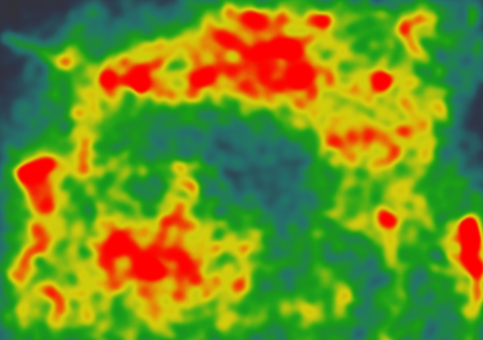

Spectrum Monitoring
Estimate the spatial distribution of signal power present in frequency F, aka Spectrum Maps
WINGS Lab
Notes:
So spectrum monitoring. Here, we assume there are transmitters transmitting in a frequency F, across different geo-locations. Our goal is to build the spectrum maps, i.e., the spatial distribution of signal power present in a particular frequency.

Slide 4
Building Spectrum Maps
How?
WINGS Lab
Notes:
So, how do we build the spectrum maps?

Slide 5

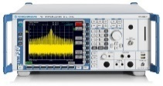
Building Spectrum Maps
Need a distributed system of spectrum sensors
Very Few Sensors → Poorer Estimate of the Spectrum Map
Spectrum Analyzer
Bulky
Expensive
Cannot be Deployed at Scale
WINGS Lab
Notes:
One method currently being used is that deploy spectrum analyzers in few locations and estimate the power. These spectrum analyzers costs like 50000 USD, and are bulky, and can’t be scaled. Therefore the result is they end up estimating the poor spectrum maps.

Slide 6
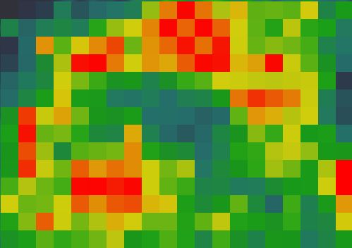
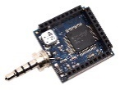
Building Spectrum Maps
More Sensors → Better Estimate of the Spectrum Map
How About Commodity Spectrum Sensors?
Smaller form-factor
Cheaper
Deployed at Scale
WINGS Lab
Notes:
Now we need a better solution right. To this end, some group of researchers came up with this idea.. Called commodity spectrum monitoring. Where we use large number of very inexpensive sensors to monitor the spectrum. The benefits are easy to carry, cheaper and easy to scale. The end result is much better estimates of spectrum maps.

Slide 7
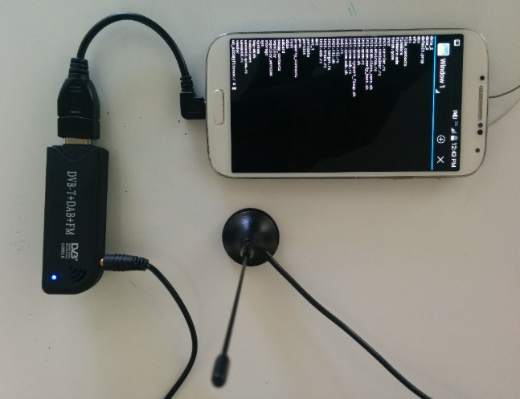
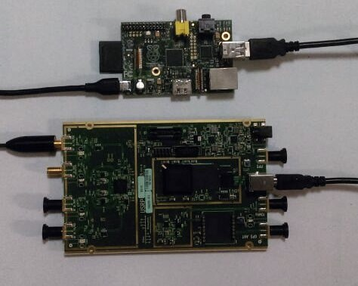
Commodity Spectrum Sensors
RTL-SDR
BladeRF
USRP B200
USRP B210
We envision that such sensors deployed in large-scale
Phone
RPi
RPi
RPi
≈ $20
≈ $200
≈ $700
≈ $1200
WINGS Lab
Notes:
So, what are such commodity spectrum sensors? Remember that I was telling there are 100s of software defined radios available in the market. We use same SDRs and attach with other cheap compute devices such as Raspberry pi or Odroid boards for sensing the spectrum and transmitting the data to cloud server. Our vision is that these sensors will be deployed nation-wide for the continuous spectrum monitoring.

Slide 8

Inside Spectrum Sensors
Computing Device
I/Q Samples
Sensing Unit
1. Send the raw IQ data directly to cloud
2. Compute FFT and send the power data
3. Run signal detection algorithms
WINGS Lab
Notes:
What these spectrum sensors essentially do is that the sensing unit which is the SDR continuously senses the spectrum and transfers the data to the computing device with a USB interface for further processing. This is because the SDRs in the market does not come up with compute or network capacity. The compute device such as Odroid board performs several functionalities on the data.

Slide 9
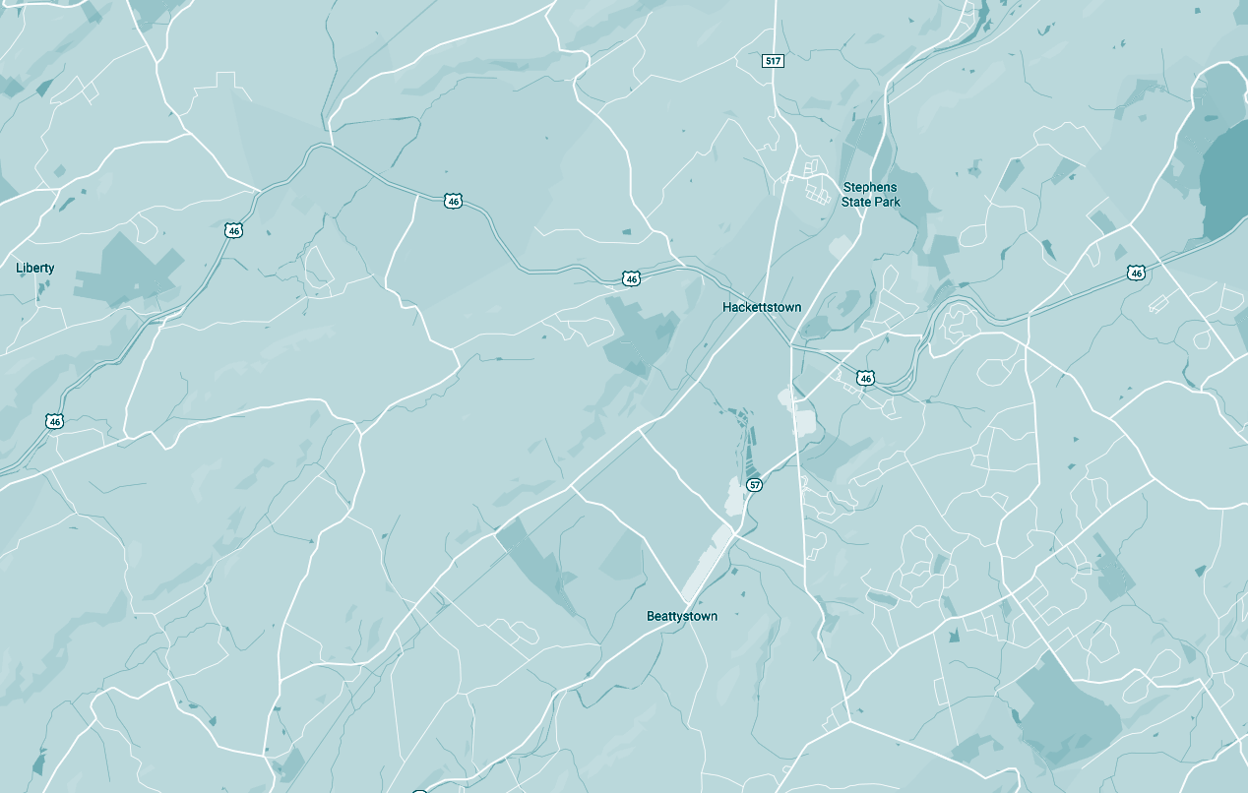
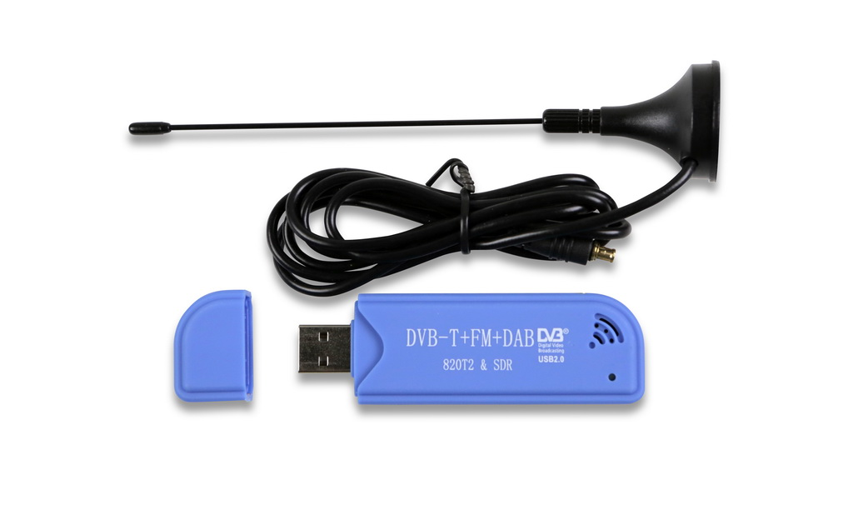
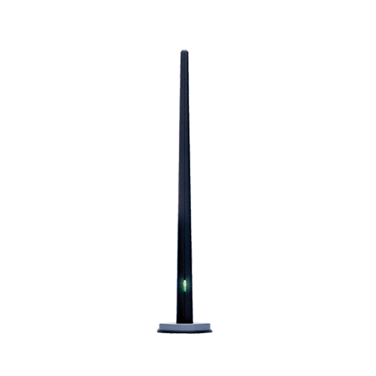


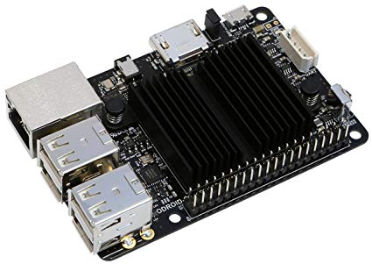
Sensing Pipeline
Parameter Space
Spectrum Sensor Deployment
Spectrum Data Cloud
Sensor Parameters
Illegal Transmitter
RTL-SDR
Database
FFT size, Sample rate, Sample size, Integration size
Spectrum
Sensor
Fusion Center
Device Parameters
Odroid
Spectrum Queries
CPU clock frequency, RAM, # of Cores, USB version
Spectrum
Sensor
Poor Capabilities
Continuous Spectrum Patrolling
Latency Sensitive Queries
The commodity sensors are resource limited and it is not straightforward to use them for sensing
WINGS Lab
Notes:
So, let me show you the overall distributed spectrum sensing pipeline. We have a spectrum data sever storing the data from all the sensors. It receives the spectrum queries from different users. Based on the query, the server tries to fuse the data of some sensors and answers the query. And here we have sensors deployed in space. And there may be some transmitters. These spectrum sensors have several parameters that impact the quality or accuracy of the spectrum sensing. The reason is that the commodity sensors are resource limited and cannot be used as is for the deployment.

Slide 10
Problem and Motivation
Detecting an intermittent transmitter
Significantly poor detection performance for
shorter transmissions
WINGS Lab
Notes:
So, what we did was as an initial experiment, we used an intermittent transmitter to transmit different lengths of signals and sleep for some time in between. One more important thing to note here is that the sensor and transmitter are placed very close and the transmitting power high enough that the sensor should be able to receive all the signal power. After sensing the power, we calculate the signal detection performance using detection ratio metric. The detection ratio is the ratio of total number of transmissions observed over actual number of total transmissions.

Slide 11
Sensing Parameters
Parameters
USRP-SDR
RTL-SDR
Parameters
Desktop
Odroid-C2
Sampling rate (Msps)
62
2.5
Clock (MHz)
3.35
1.5
Bits for each sample
12
8
CPU Cores
4
4
Spectrum (MHz - GHz)
50-6
24-1.7
Memory (GB)
8
2
WINGS Lab

Slide 12
Micro-benchmark of Spectrum Sensors
Sampling Rate
Compute Unit’s
CPU Clock Frequency
Integration Size
FFT Size
WINGS Lab

Slide 13
Impact of Sampling Rate
Increasing the sampling rate does not increase the detection performance
WINGS Lab
Notes:
This is a counterintuitive result because we expect to see an increase in detection ratio with the increase in sampling rate. This is because the sensor is unable to cope with the speed at which the samples are received under higher sampling rates (remote), and FFT and PSD computation (local). Hence, the sensor is losing many of the important samples that could otherwise detect transmissions.

Slide 14
Impact of Sampling Rate
The noise-floor makes it hard to choose a threshold for the transmission detection
WINGS Lab
Notes:
The noise-floor increases from −110 dB to −90 dB when the sampling rate increases from 1Msps to 32Msps on USRP. This becomes much worse, greater than −70 dB, for RTL-SDR because of its inaccurate analog converter.

Slide 15
Impact of Integration Size
WINGS Lab
Notes:
Integration size is the number of samples used for one FFT. Decreasing the integration size increases the accuracy of FFT computations, but also increases the amount of computation power needed to compute it. Whereas increase it leads to averaged power with many samples and hence making it difficult to detection micro-transmissions.

Slide 16
Impact of FFT Size
WINGS Lab
Notes:
FFT size defines the number of bins while computing the FFT. Each bin represents the resolution of frequency. The tradeoff here is that increasing the FFT size leads to more compute and buffer overflows and decreasing it leads to mixing the signal power with noise and leading it to difficult to detect micro-transmissions.

Slide 17
Direct Impact of Device Performance
WINGS Lab

Slide 18
Direct Impact of Device Performance
WINGS Lab

Slide 19
Summary of Insights
The optimal sensing parameters need to be rethought for
commodity distributed spectrum sensing.
Even when all signal processing is done remotely, the impact of using low-end processors in the spectrum sensor could be significant
For local processing, availability of compute power is a much bigger factor than the type of spectrum sensor
WINGS Lab

Slide 20
A Possible Solution
Deploy more sensors at the same location and fuse the data
WINGS Lab

Slide 21
Conclusion and Future Work
It is not straightforward to use commodity spectrum sensors for large-scale spectrum patrolling
In future, we envision alternatives such as replacing the inexpensive compute devices with FPGAs to improve the performance
Next, we look forward to scanning large range of spectrum
WINGS Lab

